Slide 1
ASAP Stamps Ltd
Now offering our Trade Customers a modern, simple way to display up to date Rubber Stamp and other related product information.
Our new Custom Stamps Fast website offers:
A choice of two templates
Enquiries sent directly to your email address
Updated regularly
Customised with your logos and contact details

Slide 2
ASAP Stamps Ltd
Two Page Template
Displays a larger range of products, including the three main brands:
MaxStamp
Trodat
Colop
The second page has frequently asked questions and video links

Slide 3
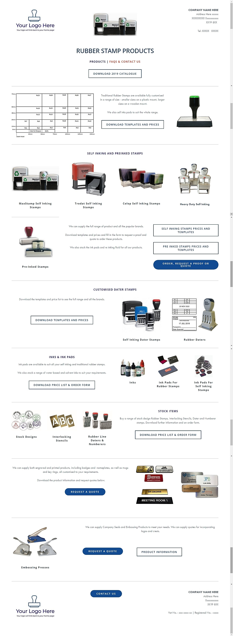
Your Name and contact details here
Your logo will have a link directly back to your own website
This year’s catalogue can be customised with your details and logo.
Downloadable pdf of size templates and price lists.
Price lists can be removed or your own uploaded.
Various Contact us forms all can be customised and will be emailed directly to you.
Logo linking back to your website, the footer can also have all your contact details.

Slide 4
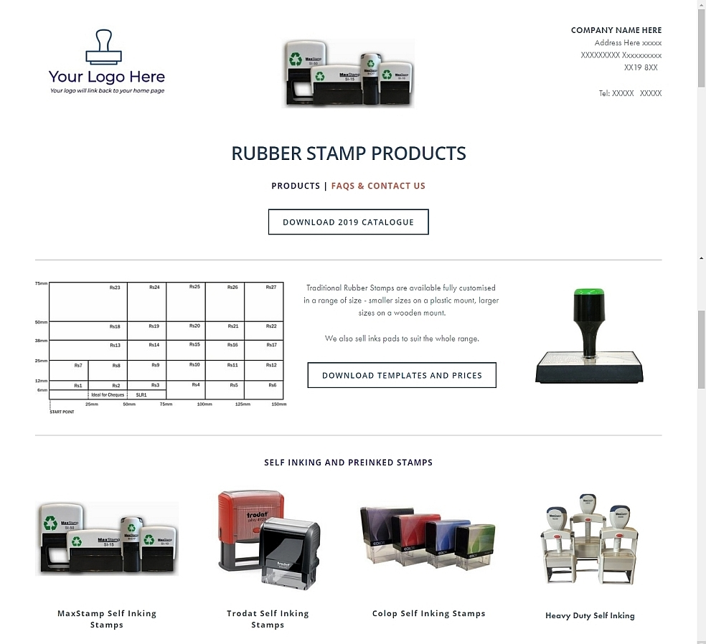
Your Name and contact details here
Your logo will have a link directly back to your own website
This year’s catalogue can be customised with your details and logo.
Downloadable pdf of size templates and price lists. Prices can be removed, or we can upload your own price list if you prefer.

Slide 5
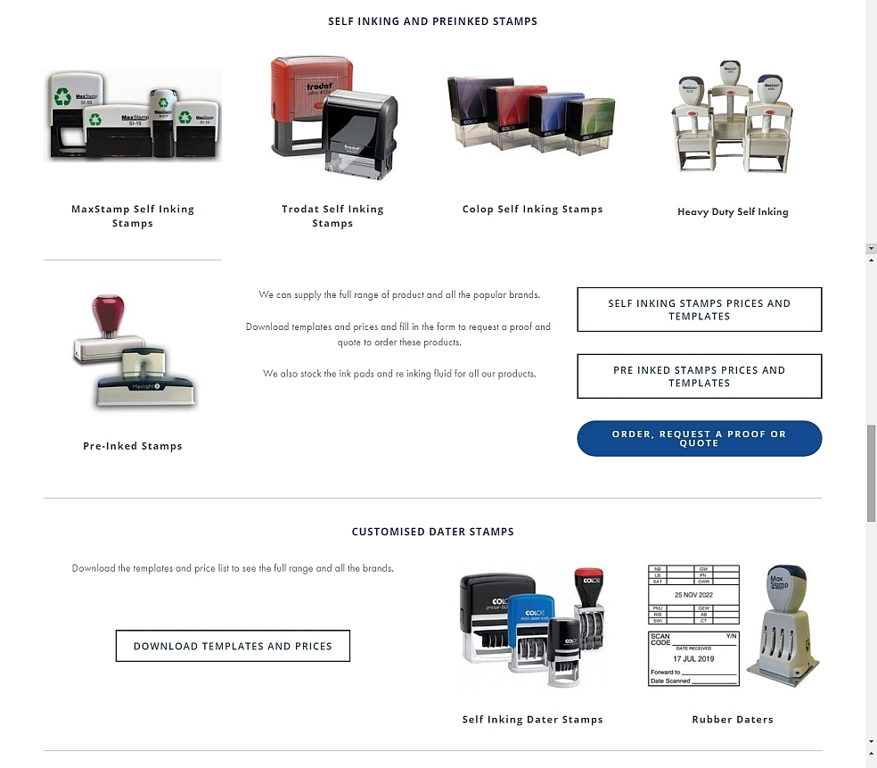
Price lists can be removed or your own uploaded.

Slide 6
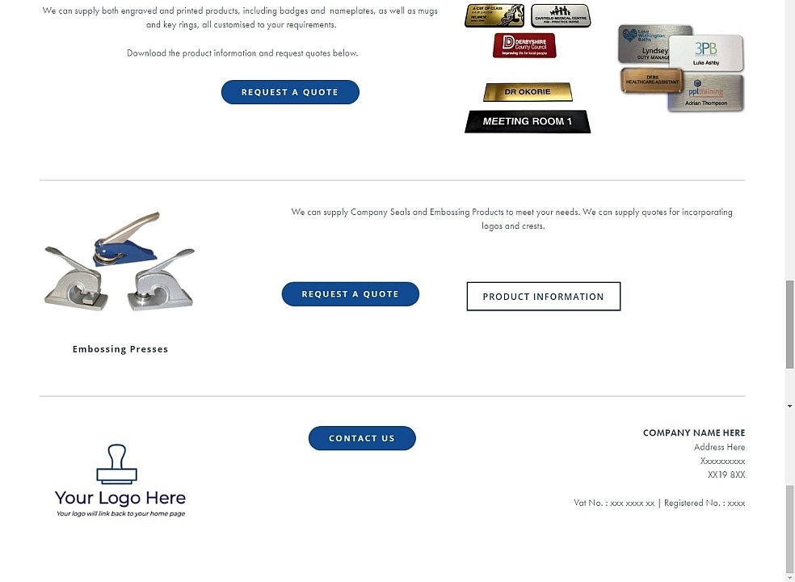
Various Contact us forms all can be customised and will be emailed directly to you.
Logo linking back to your website, the footer can also have all your contact details.

Slide 7
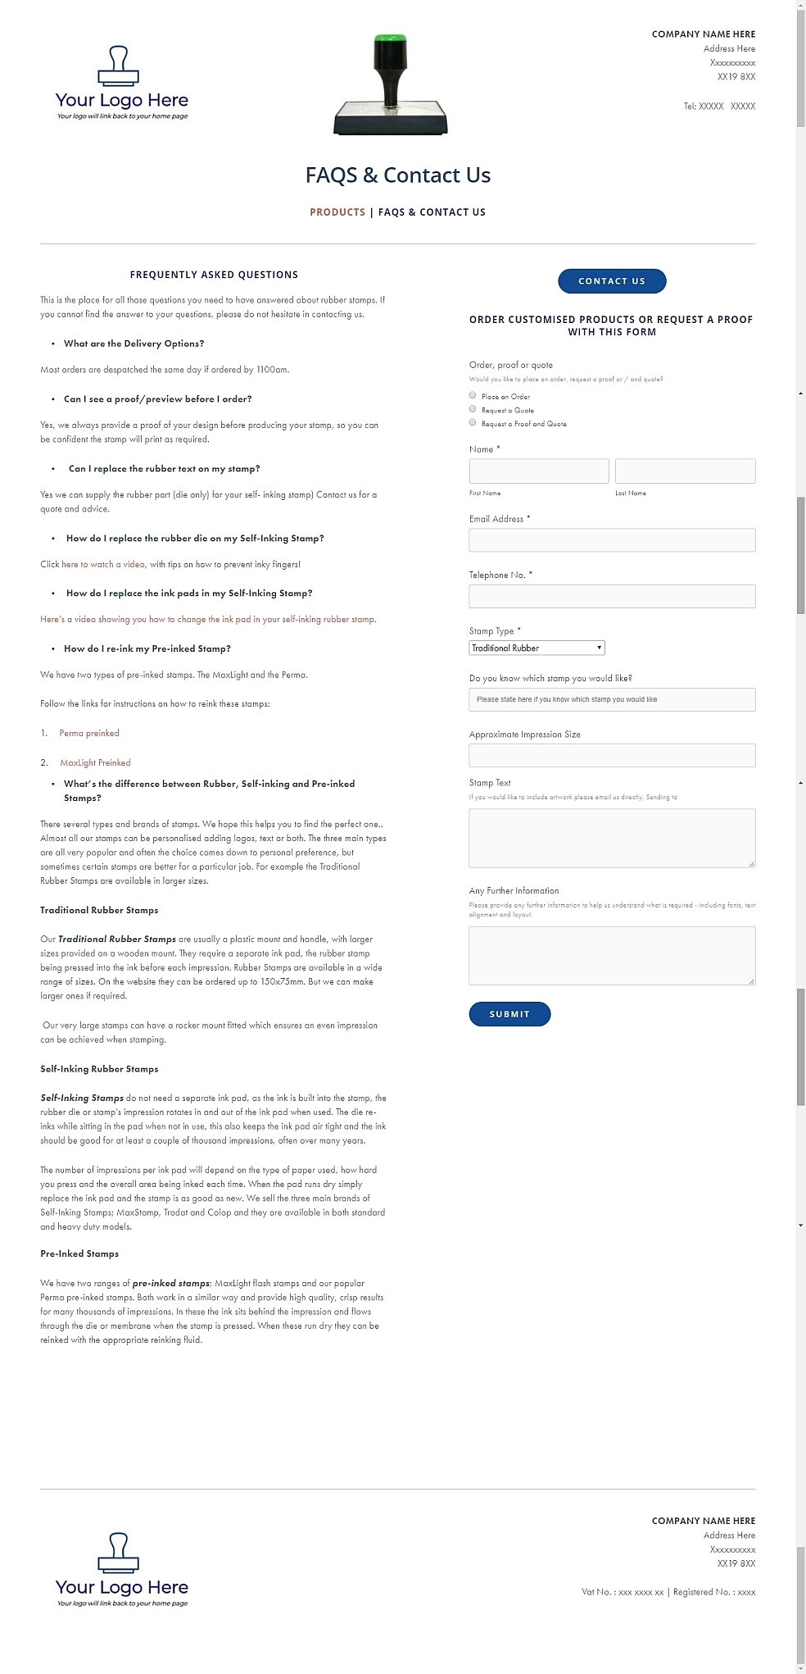
There are various Contact Us forms. All these can be customised and will be emailed directly to you, with enquiries from your customers

Slide 8
ASAP Stamps Ltd
One Page Template
Concentrates on the MaxStamp range
There is a downloadable pdf of FAQs with video links
Has contact forms and downloaded templates

Slide 9
